Slide 1

COVID -19 Predictor using End-to-End AIOps
SUBMITTED BY:
Nishkarsh Raj(500060720) Karan Nautiyal(500060911) Megha Rawat(500059999) Rishabh Negi (500060227)
Under the Guidance of
Dr. Hitesh Kumar Sharma

Slide 2
Abstract
COVID-19 situation was declared as a pandemic by WHO as it was spreaded across the world.
With India on the second rise of covid cases the burden on frontline workers has been greater than ever.
This project intends to offload the testing load from the medical workers.

Slide 3
Introduction
What was the impact of pandemic on the population?
Crowding at screening locations increase burden at an already overburdened medical system.
Physical testing locations can expose healthy individuals to the virus.
This project aims to create an AIOPs pipeline for deploying a containerized application that helps detect covid from medical scans of an individual.

Slide 4
Problem Statement
The time spent testing can be better utilized for attending to the patients.
It is better to have an automated screening process before the testing to ensure only highly susceptible individuals arrive at physical testing locations.

Slide 5
OBJECTIVES
The aim is to:
A pre-screener before needing to visit the physical location for the RT-PCR test.
To get a better understanding of the extent of the disease.
To provide a method to constantly develop new models and deploy them efficiently.

Slide 6
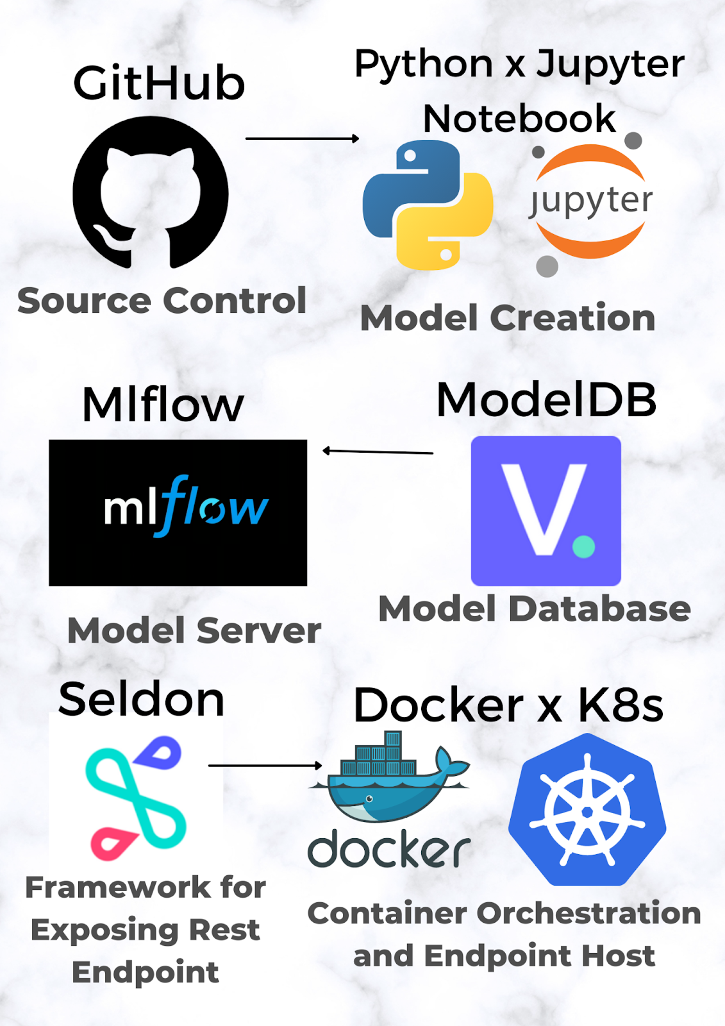
Proposed Method
This project uses public data set populated by Israel’s health ministry for training
A pytorch based machine learning pipeline is created to build a two-classification model (Covid and Non-Covid)
The machine learning model is then serialized with cloud pickle.
A predictor function is wrapped around the model to take images of CT scan as an input and return which class the image belongs to.
For hosting the model’s predictor function publicly, we expose REST and gRPC endpoints by migrating the predictor function to the Seldon framework.
Containerized application wrapper is created with Docker and hosted publicly on managed Kubernetes.
Model storage is handled with an instance of the Verta AI’s ModelDB platform.
For logging and registration of the model for endpoints in gRPC, Mlflow functionality support is added.

Slide 7
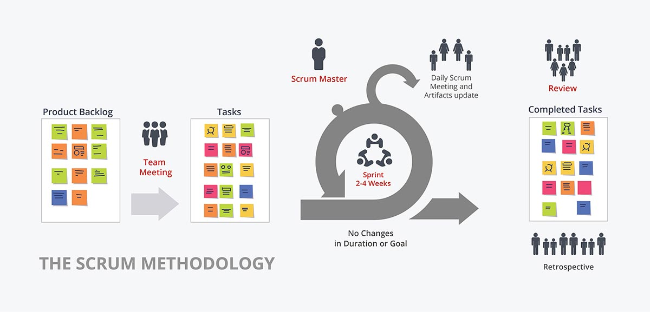
SDLC - SCRUM MODEL
The entire project is divided into individual modules, based on their functionalities.
It’ll developed in isolation by the entire team, based on the priority of implementation using Git.

Slide 8
Efficiency Parameters
Sensitivity: The test should be sensitive enough to not miss many positive cases as that defeats the purpose.
Specificity:The model requires moderate specificity as someone with a false positive result can always go to a physical screening location.
Frequency: The frequency of updates should be as much as possible to ensure the model is relevant.
Accuracy: The model is trained with 60 epochs for image dataset size of 1000 images with 80% accuracy. We want to improve the accuracy with better training

Slide 9
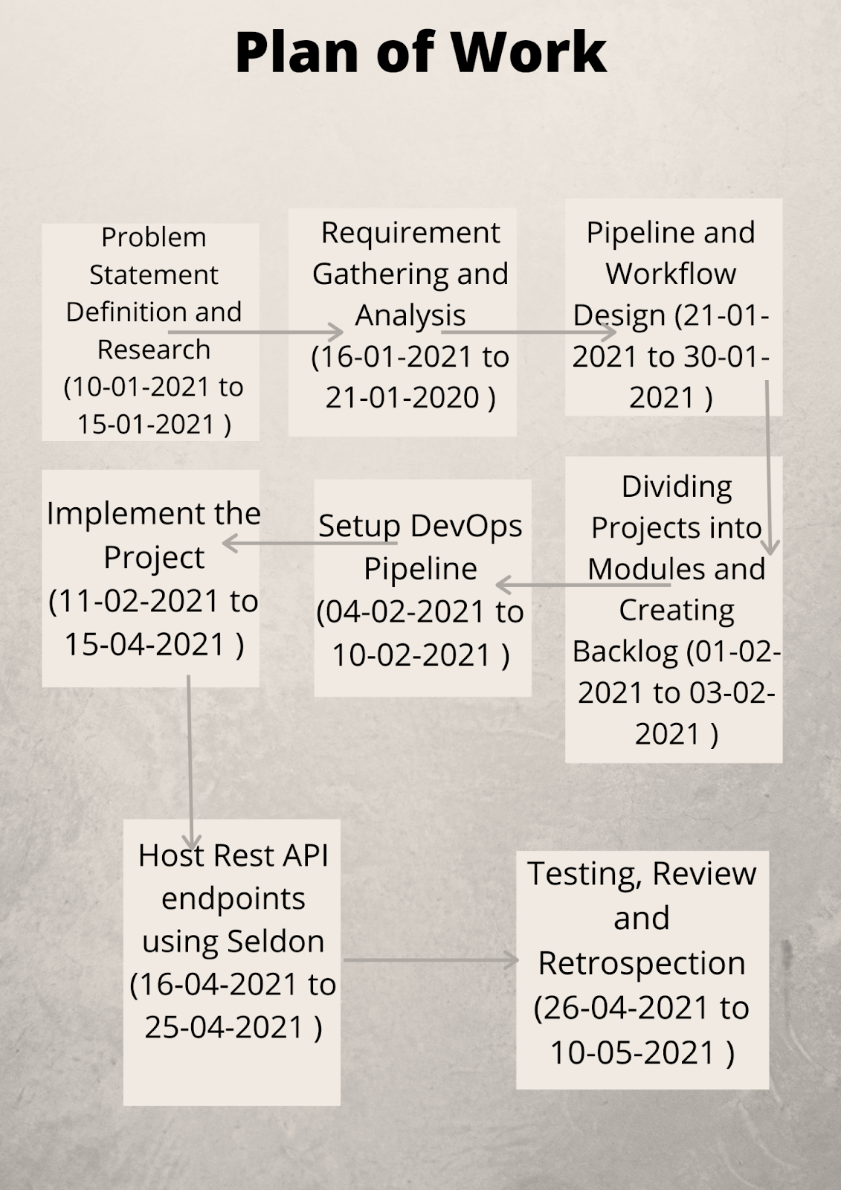

Slide 10
Project progress
Product Log :
Research about a reliable and up-to-date data source for Covid-19
Create a GitHub repository to collaborate in a distributed environment
Create a .gitignore file to ignore python executables and dependencies
Create a .dockerignore file to optimize the production level Docker build
Create a pipeline to generate a machine learning model using pytorch which is serialized with pickle.
Create a metric evaluation code to find accuracy, specificity and Area under ROC of the model.
Create a predictor function that takes URL/local image as input and generates prediction of Covid19

Slide 11
Cont...
8. Migrate the predictor function into Seldon framework
9. Create an optimized docker image of the Seldon workflow of the model
10. Expose REST Endpoints of the model with Docker and Kubernetes
11. Host a Model storage server with Verta AI’s ModelDB
12. Log and Register Models in Mlflow
13. Serve gRPC endpoints in MLflow

Slide 12
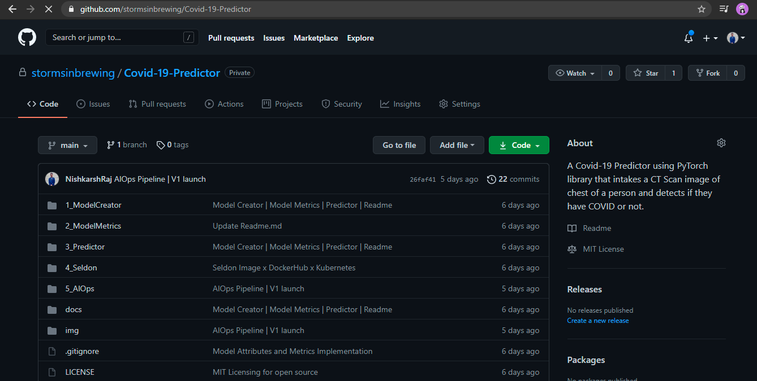
Increment of Sprint I (Sprint Review)
Host the project on GitHub -
https://github.com/stormsinbrewing/Covid-19-Predictor

Slide 13
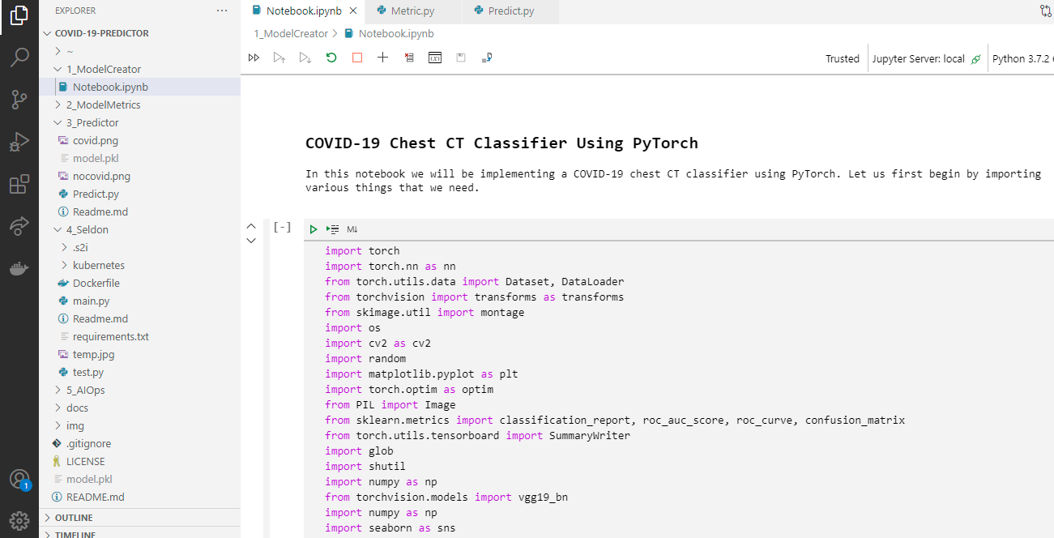
2. Create Pipeline in Jupyter Notebook to create a machine learning model with Pytorch library and pickle serialization

Slide 14
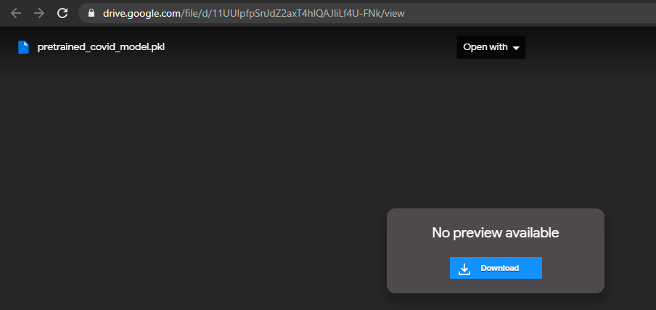

Slide 15
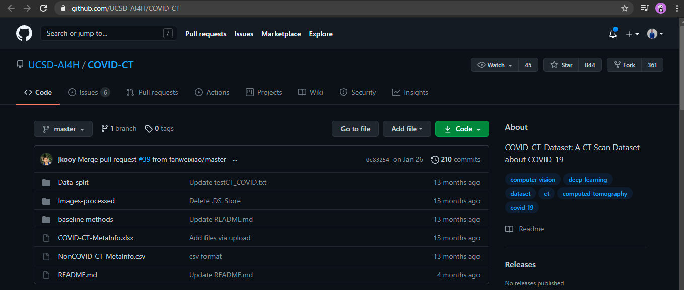
3. Download the dataset from https://github.com/UCSD-AI4H/COVID-CT

Slide 16
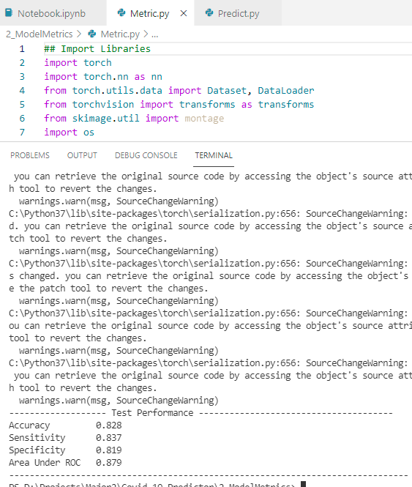
4. Write a model evaluation function in python to derive accuracy, specificity and AREA under ROC

Slide 17
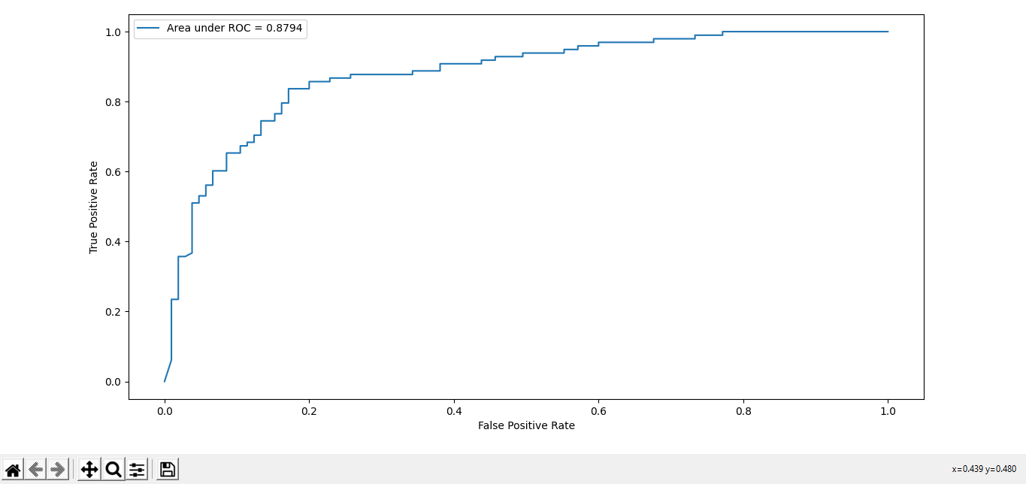

Slide 18
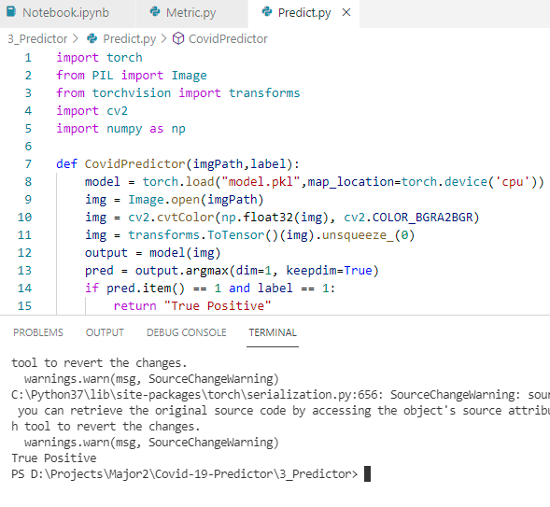
5. Write a Predictor function that takes an image of CT scan of the chest and predicts whether you are Covid positive or not based on the model created.

Slide 19
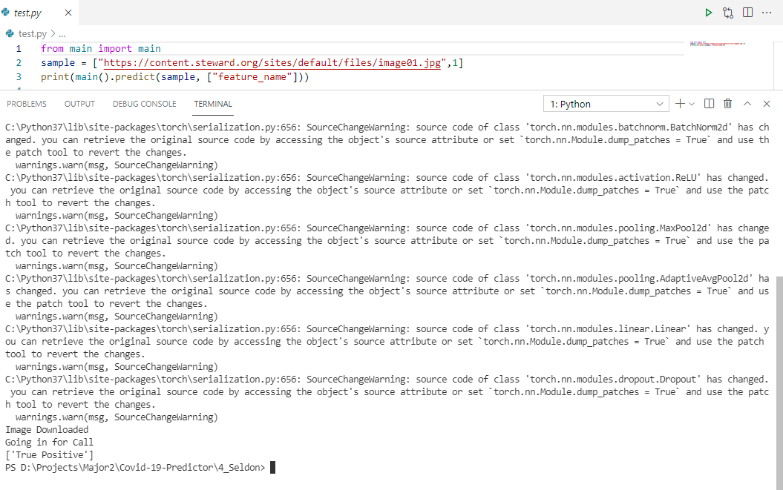
6. Migrate the predictor code to Seldon Framework to support REST and gRPC calls.

Slide 20
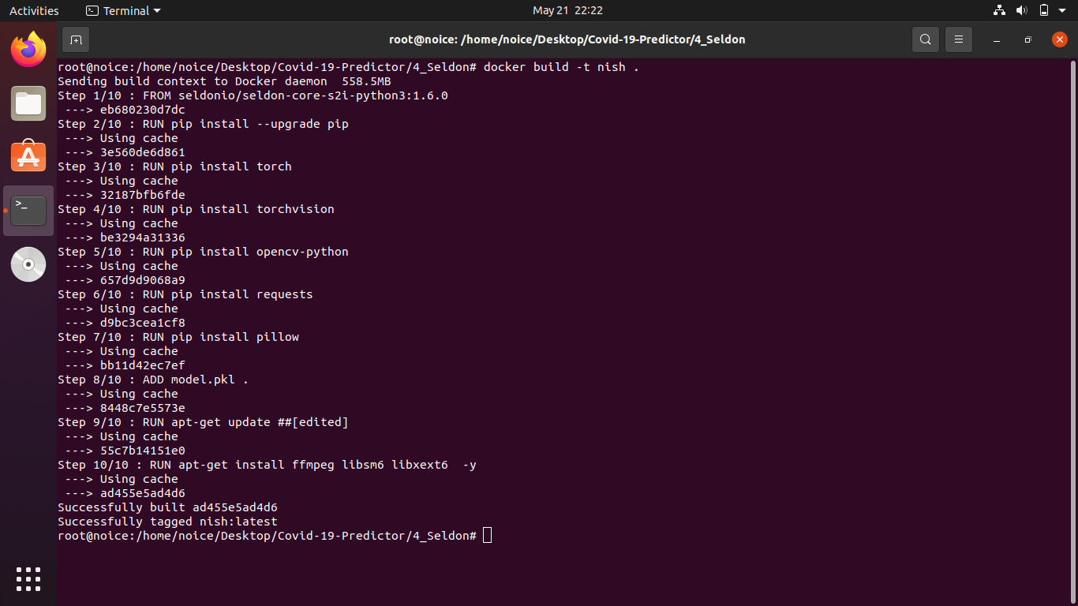
7. Build a base docker image for Seldon functionality

Slide 21
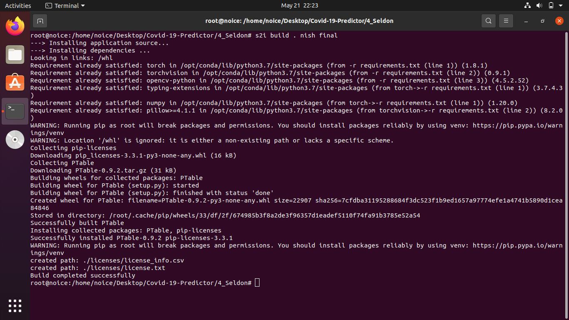
8. Create a seldon image using S2I functionality

Slide 22
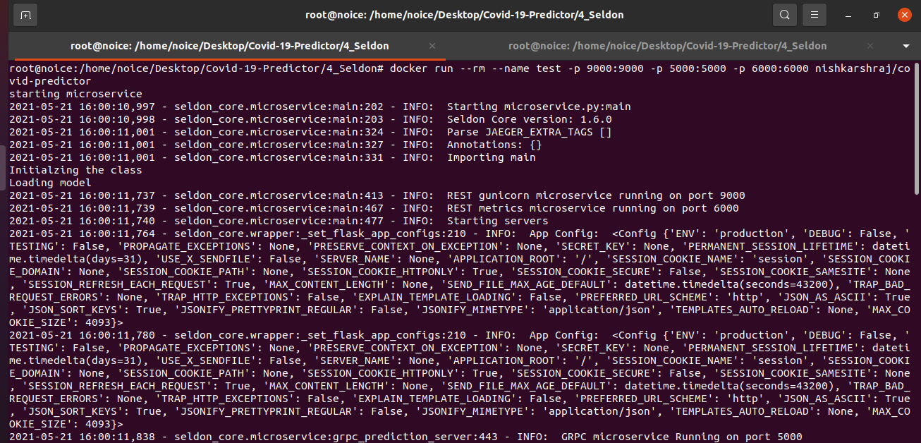
9. Expose REST Endpoints using Docker on local server with Seldon

Slide 23
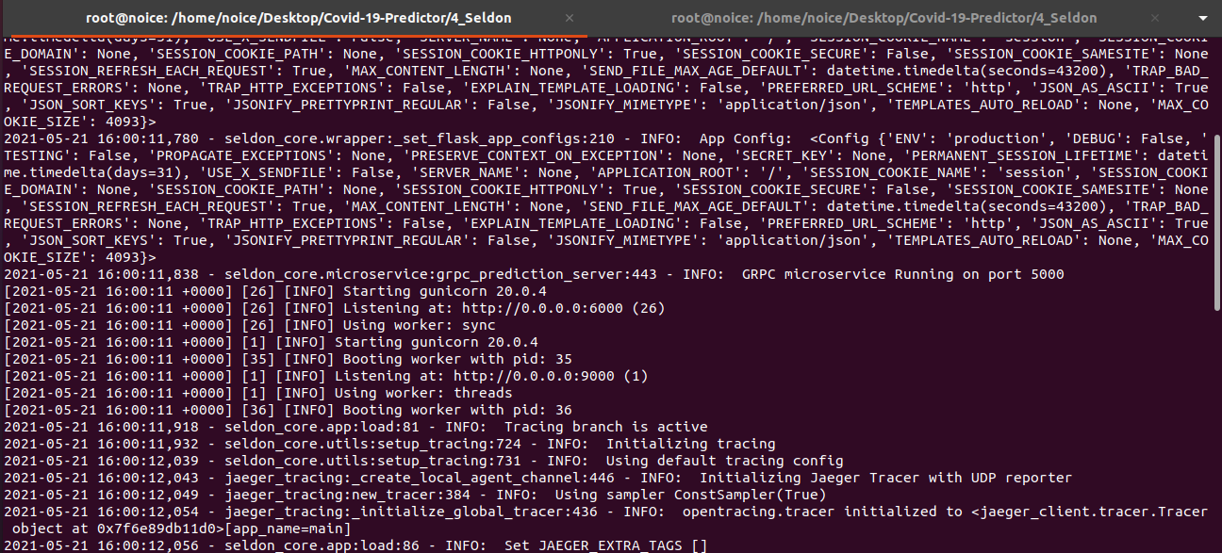

Slide 24
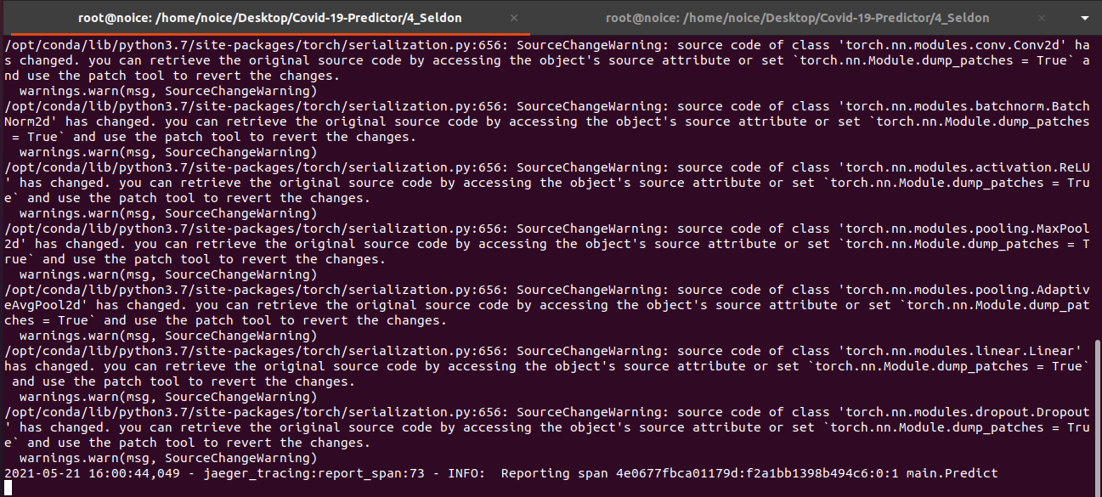

Slide 25
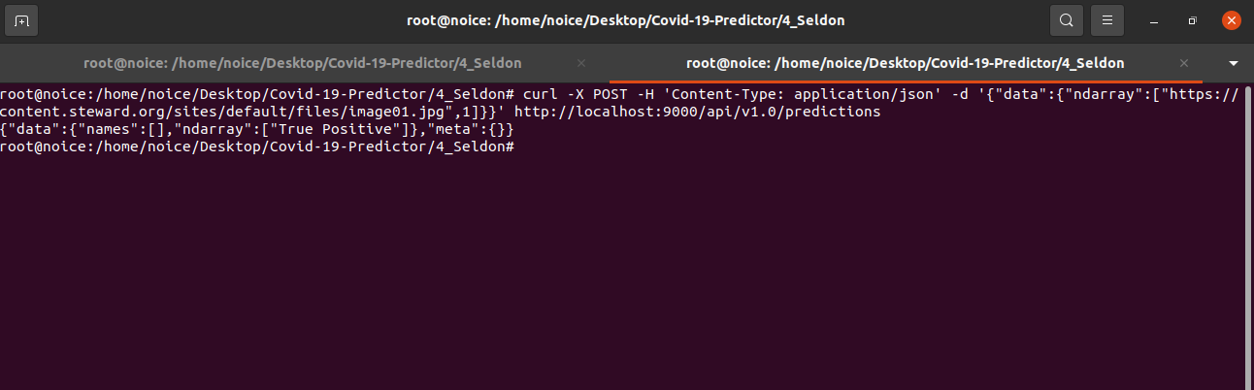

Slide 26
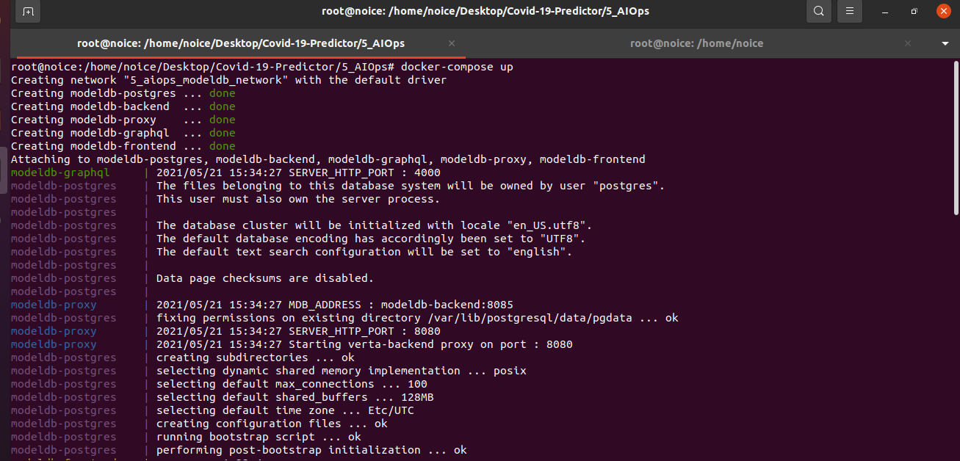
10. Host ModelDB on a local server for Model storage.

Slide 27
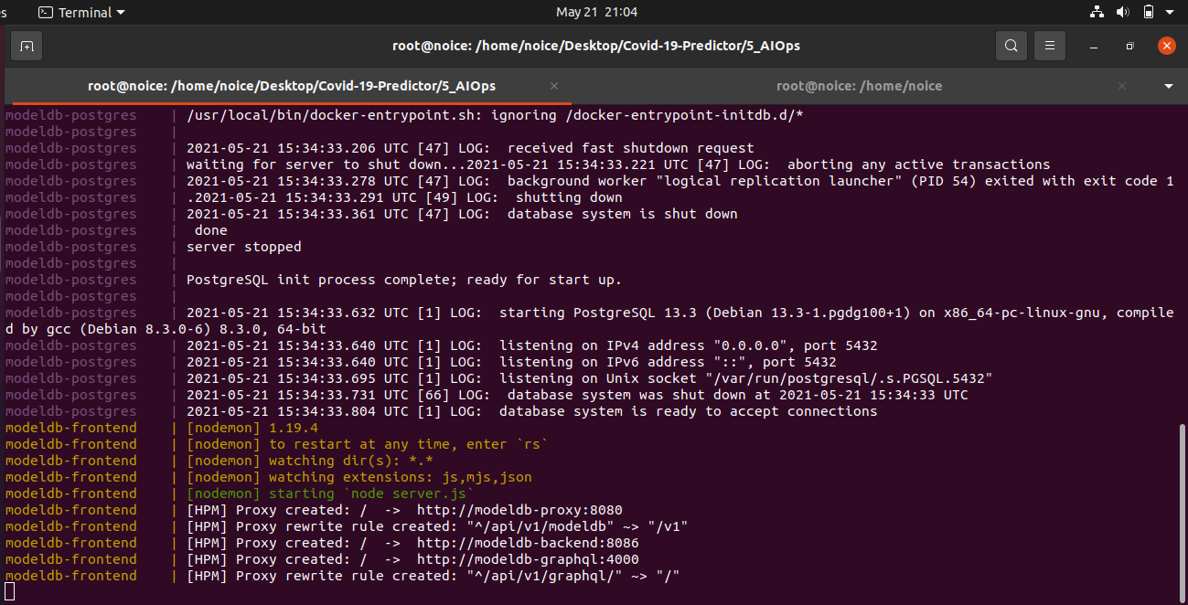

Slide 28
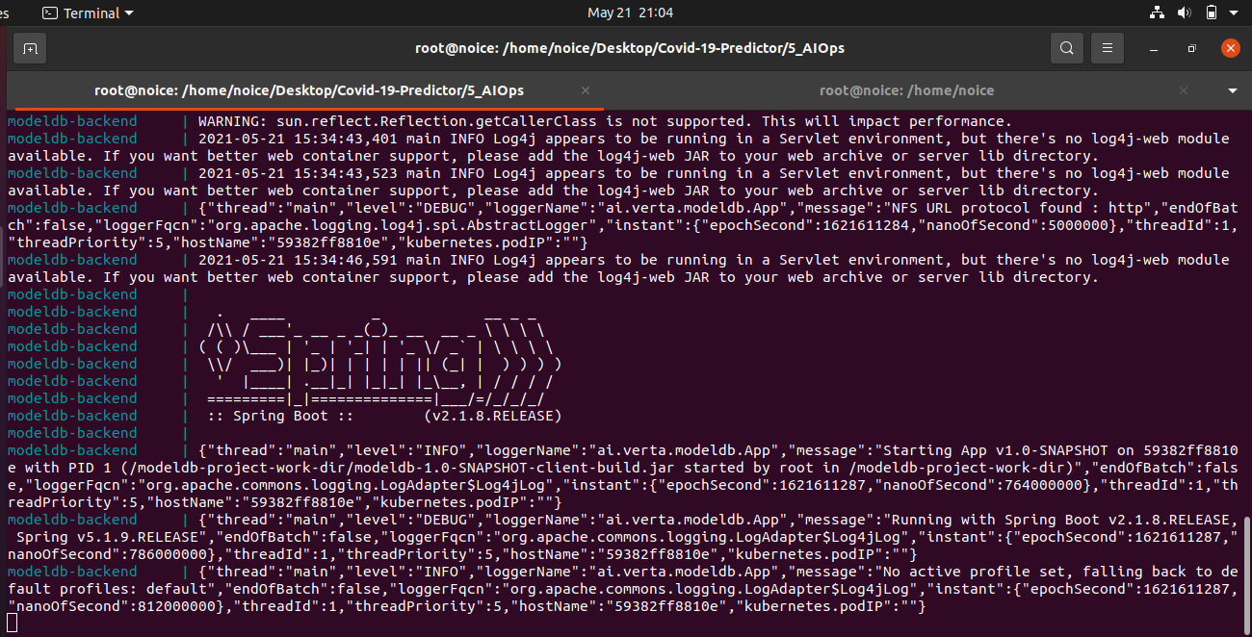

Slide 29
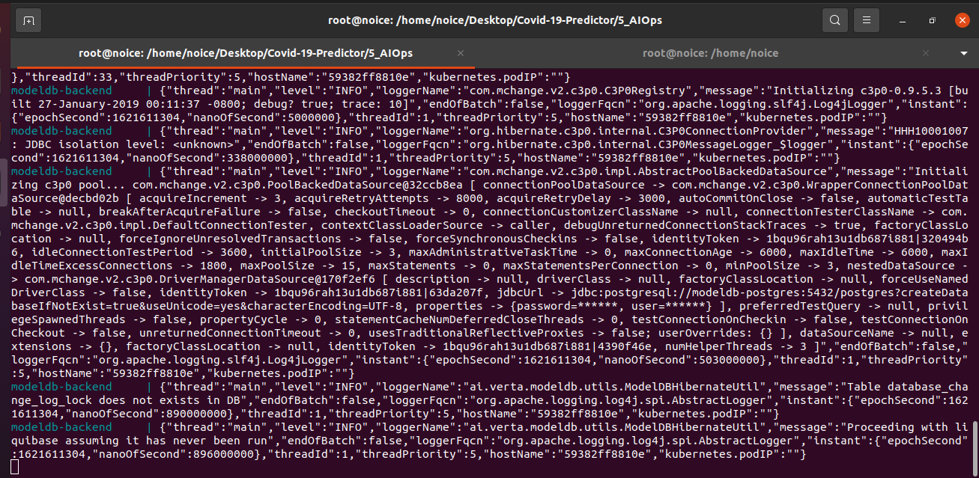

Slide 30
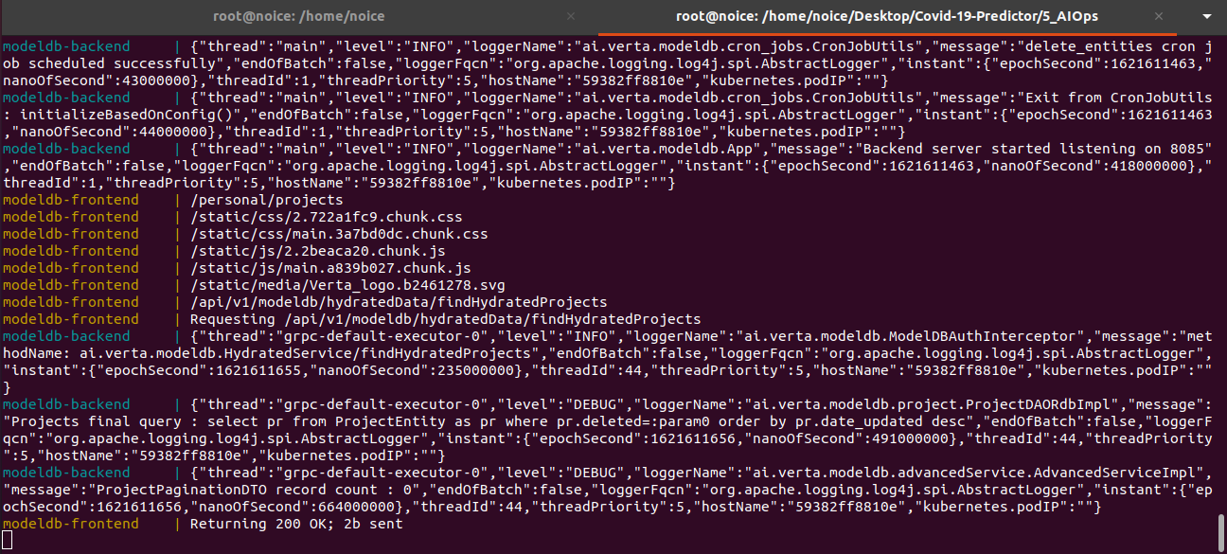

Slide 31
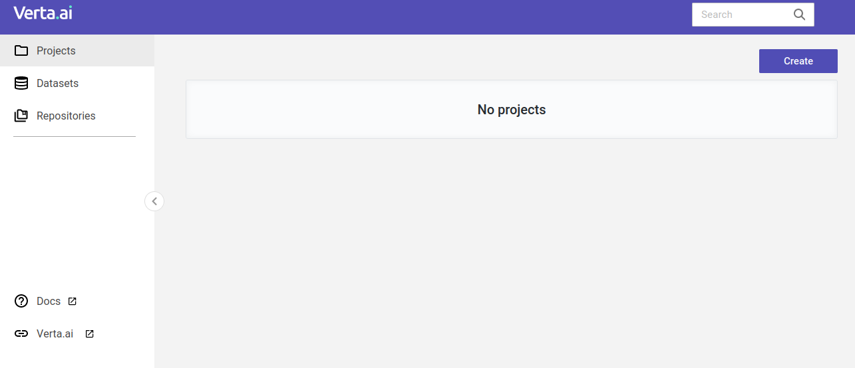

Slide 32
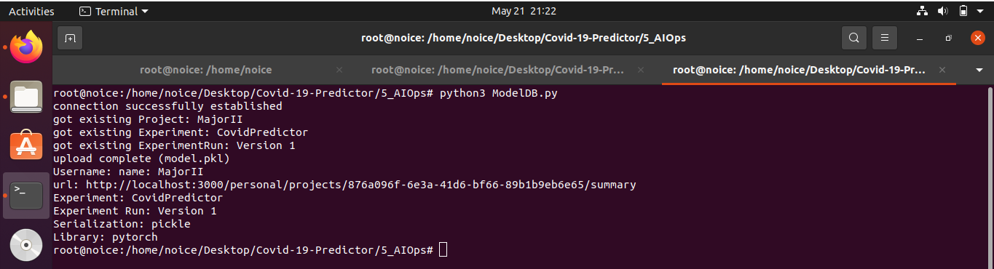
11. Log Model in Mlflow and serve gRPC endpoint

Slide 33
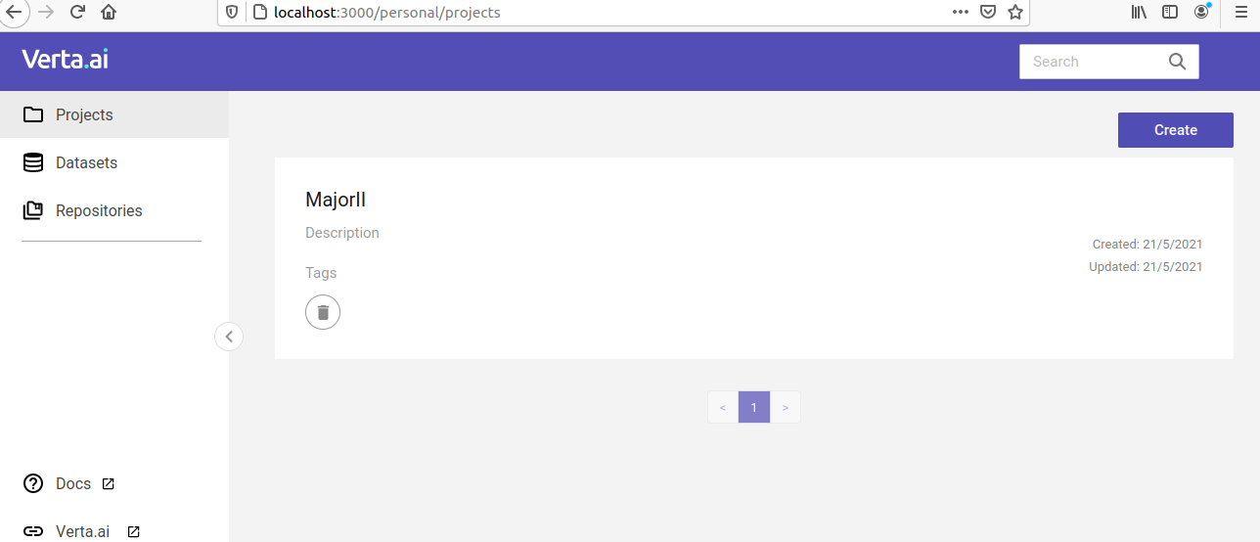

Slide 34
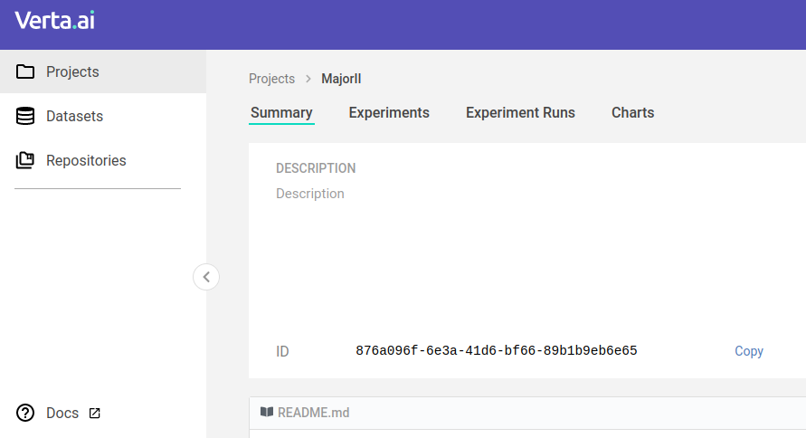

Slide 35
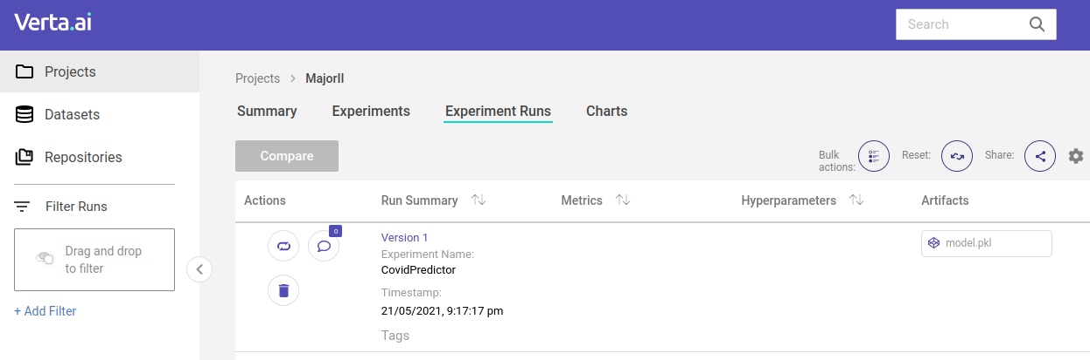

Slide 36
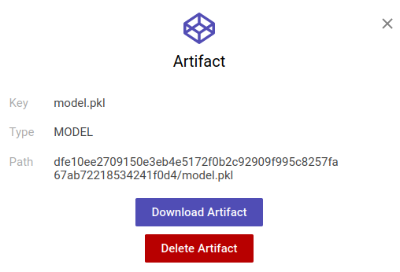

Slide 37
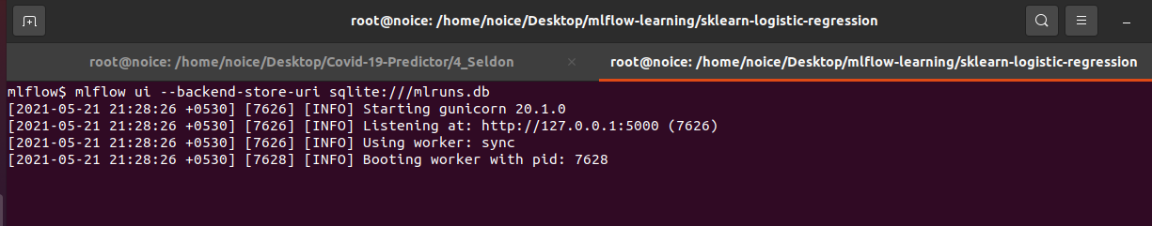
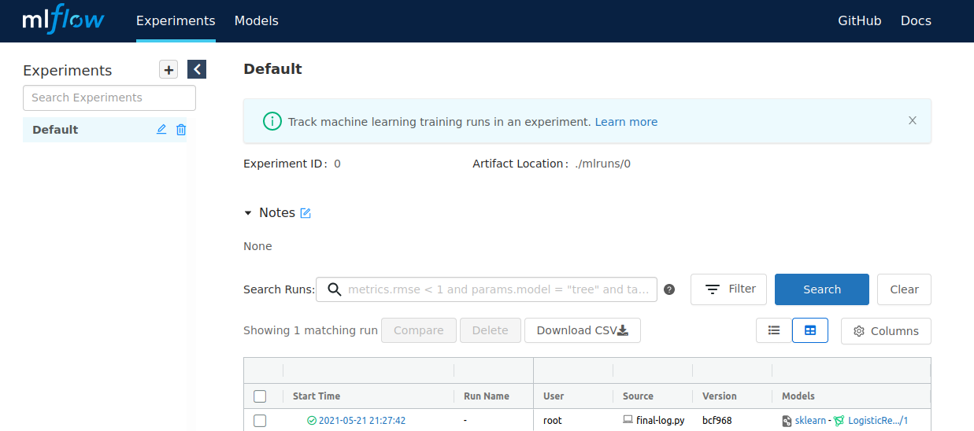

Slide 38
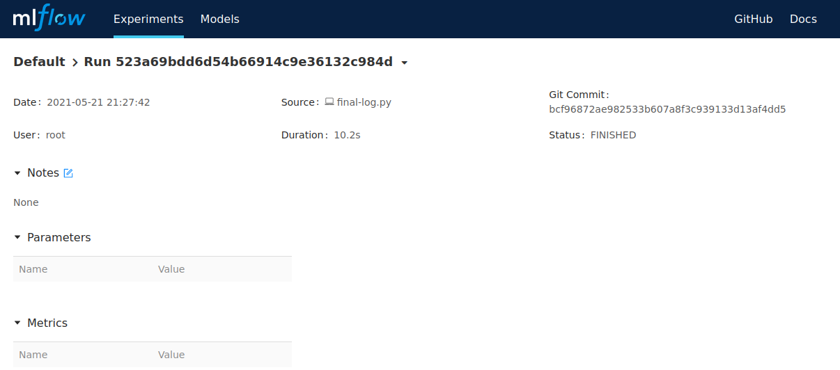

Slide 39


Slide 40
References
[1] Dong, E., Du, H. & Gardner, L. An interactive web-based dashboard to track COVID-19 in real time. Lancet Infect. Dis. https://doi.org/10.1016/S1473-3099(20)30120-1 (2020).
[2] Gozes, O. et al. Rapid AI development cycle for the coronavirus (COVID-19) pandemic: initial results for automated detection & patient monitoring using deep learning CT image analysis. arXiv e-prints 2003, arXiv:2003.05037 (2020).
[3] Song, Y. et al. Deep learning Enables Accurate Diagnosis of Novel Coronavirus (COVID-19) with CT images. medRxiv https://doi.org/10.1101/2020.02.23.20026930 (2020).
[4] Wang, S. et al. A deep learning algorithm using CT images to screen for CoronaVirus Disease (COVID-19). medRxiv, https://doi.org/10.1101/2020.02.14.20023028 (2020).

Slide 41
Cont..
[5] Jin, C. et al. Development and evaluation of an AI system for COVID-19 diagnosis. medRxiv, https://doi.org/10.1101/2020.03.20.20039834 (2020).
[6] Punn, N. S. & Agarwal, S. Automated diagnosis of COVID-19 with limited posteroanterior chest X-ray images using fine-tuned deep neural networks. arXiv:2004.11676 [cs, eess] (2020).
[7] Tostmann, A. et al. Strong associations and moderate predictive value of early symptoms for SARS-CoV-2 test positivity among healthcare workers, the Netherlands, March 2020. Eurosurveillance 25, 2000508 (2020).
[8] Feng, C. et al. A novel triage tool of artificial intelligence assisted diagnosis aid system for suspected COVID-19 pneumonia in fever clinics. medRxiv, https://doi.org/10.1101/2020.03.19.20039099 (2020)
[9] Punn, N. S., Sonbhadra, S. K. & Agarwal, S. COVID-19 Epidemic Analysis using Machine Learning and Deep Learning Algorithms. medRxiv, https://doi.org/10.1101/2020.04.08.20057679 (2020).

Slide 42


